Slide 1
CREATING AN ARCHITECTURAL DESIGN
Madheswari.K
AP/CSE

Slide 2
Topics Covered
Software Architecture
Data design
Architectural styles and patterns
Architectural design
Assessing alternative architectural designs
Mapping Dataflow into a Software Architecture

Slide 3
Software Architecture

Slide 4
Software Architecture
What Is Architecture?
Why Is Architecture Important?

Slide 5
What Is Architecture?
“The architecture of a system is a Comprehensive framework that describes its form and structure—its components and how they fit together.”
Software Architecture
Software architecture must model the structure of a system and the manner in which data and procedural components collaborate with one another.
The software architecture of a program or computing system is the structure or structures of the system, which comprise software components, the externally visible properties of those components, and the relationships among them.

Slide 6
Why Is Architecture Important?
three key reasons that software architecture is important:
Representations of software architecture are an enabler for communication between all parties (stakeholders) interested in the development of a computer-based system.
The architecture highlights early design decisions that will have a profound impact on all software engineering work that follows and, as important, on the ultimate success of the system as an operational entity.
Architecture “constitutes a relatively small, intellectually graspable model of how the system is structured and how its components work together”

Slide 7
Data design

Slide 8
Architectural styles and patterns

Slide 9
Architectural styles
Architectural styles:
An architectural style is a transformation that is imposed on the design of an entire system. The intent is to establish a structure for all components of the system. In the case where an existing architecture is to be reengineered the imposition of an architectural style will result in fundamental changes to the structure of the software including a reassignment of the functionality of components
The software that is built for computer-based systems also exhibits one of many architectural styles
Each style describes a system category that encompasses (1) a set of components (e.g., a database, computational modules) that perform a function required by a system;
(2) a set of connectors that enable “communication, coordination
and cooperation” among components;

Slide 10
Architectural styles contd…
(3) constraints that define how components can be integrated to form the system;
(4) semantic models that enable a designer to understand the overall properties of a system by analyzing the known properties of its constituent parts

Slide 11
Pattern Vs Architectural Styles
a pattern differs from a style in a number of fundamental ways
the scope of a pattern is less broad, focusing on one aspect of the architecture rather than the architecture in its entirety;
(2) a pattern imposes a rule on the architecture, describing how the software will handle some aspect of its functionality at the infrastructure level
(3) Architectural patterns tend to address specific behavioral issues within the context of the architecture (e.g., how real-time applications handle synchronization or interrupts).
(4) Patterns can be used in conjunction with an architectural style to shape the overall structure of a system.

Slide 12
A Brief Taxonomy of Architectural Styles
Data-centered architectures
Data-flow architectures.
Call and return architectures
Object-oriented architectures.
Layered architectures.

Slide 13
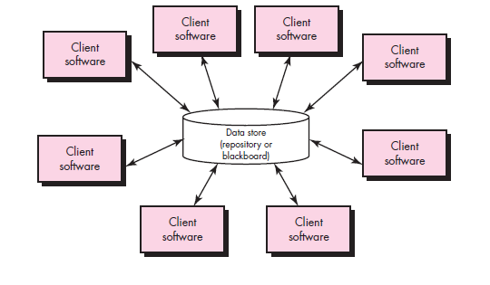
Data-centered architectures

Slide 14
Data-centered architectures
A data store (e.g., a file or database) resides at the center of this architecture and is accessed frequently by other components that update, add, delete, or otherwise modify data within the store.
Client software accesses a central repository. In some cases the data repository is passive. That is, client software accesses the data independent of any changes to the data or the actions of other client software
Data-centered architectures promote integrability. That is, existing components can be changed and new client components added to the architecture without concern about other clients (because the client components operate independently).
In addition, data can be passed among clients using the blackboard mechanism (i.e., the blackboard component serves to coordinate the transfer of information between clients).

Slide 15
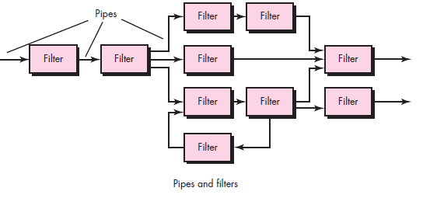
Data-flow architectures

Slide 16
Data-flow architectures
This architecture is applied when input data are to be transformed through a series of computational or manipulative components into output data.
A pipe-and-filter pattern has a set of components, called filters, connected by pipes that transmit data from one component to the next.
Each filter works independently of those components upstream and downstream, is designed to expect data input of a certain form, and produces data output (to the next filter) of a specified form.
However, the filter does not require knowledge of the workings of its neighboring filters.

Slide 17
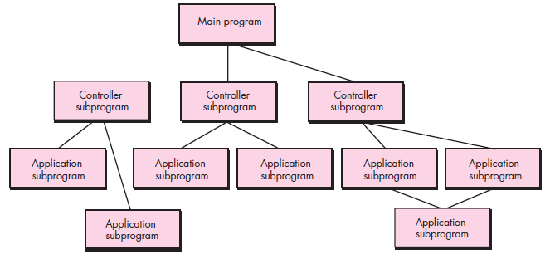
Call and return architectures

Slide 18
Call and return architectures
This architectural style enables you to achieve a program structure that is relatively easy to modify and scale.
A number of substyles exist within this category:
1. Main program/subprogram architectures.
2. Remote procedure call architectures
Main program/subprogram architectures. This classic program structure decomposes function into a control hierarchy where a “main” program invokes a number of program components that in turn may invoke still other components.
Remote procedure call architectures. The components of a main program/subprogram architecture are distributed across multiple computers on a network.

Slide 19
Object-oriented architectures.
The components of a system encapsulate data and the operations that must be applied to manipulate the data. Communication and coordination between components are accomplished via message passing.

Slide 20
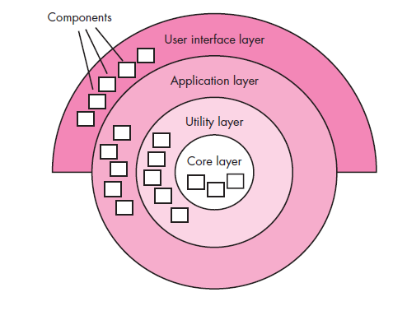
Layered architectures.

Slide 21
Layered architectures
At the outer layer, components service user interface operations.
At the inner layer, components perform operating system interfacing.
Intermediate layers provide utility services and application software functions.

Slide 22
Architectural Patterns
A software architecture may have number of architectural patterns the address issues such as concurrency, persistence,
And distribution.
Concurrency
There are number of different ways to handle concurrency, and each can be represented by a different architectural pattern.
1)Operating System Process Management Patterns :
It provides built-in OS features that allow components to execute concurrently.
2) A Task Scheduler patterns

Slide 23
Architectural Patterns
Persistence:
Two architectural patterns used to achieve persistence.
1) database management system pattern : that applies the storage and retrieval capability of a DBMS to the application architecture.
2) Application level persistence pattern:
that builds persistence features into application architecture
Distribution
Broker Pattern: broker act as a middle-man between the client component and a server component.
Example:CORBA

Slide 24
Organization and Refinement
How do I assess an architectural style that has been derived?
Control
How is control managed within the architecture?
Does a distinct control hierarchy exist, and if so, what is the role of components within this control hierarchy?
Data
How are data communicated between components?
What is then mode of data transfer?
Are data components passive or active

Slide 25
Architectural design

Slide 26
Architectural design
Representing the System in Context
Defining Archetypes
Refining the Architecture into Components
Describing Instantiations of the System

Slide 27
Representing the System in Context
At the architectural design level, a software architect uses an architectural context diagram (ACD) to model the manner in which software interacts with entities external to its boundaries.
How do systems interoperate with one another?
Superordinate systems—those systems that use the target system as part of some higher-level processing scheme.
Subordinate systems—those systems that are used by the target system and provide data or processing that are necessary to complete target system functionality.
Peer-level systems—those systems that interact on a peer-to-peer basis (i.e., information is either produced or consumed by the peers and the target system.
Actors—entities (people, devices) that interact with the target system by producing or consuming information that is necessary for requisite processing.

Slide 28
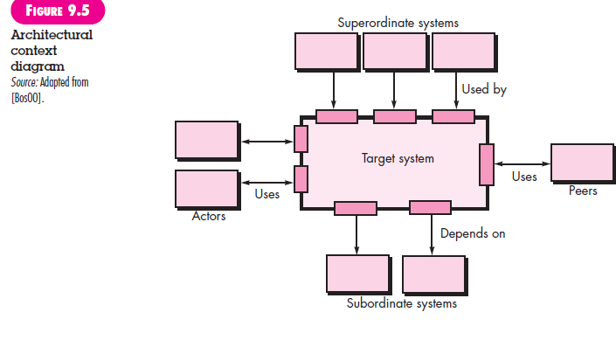
Architectural context diagram (ACD)

Slide 29
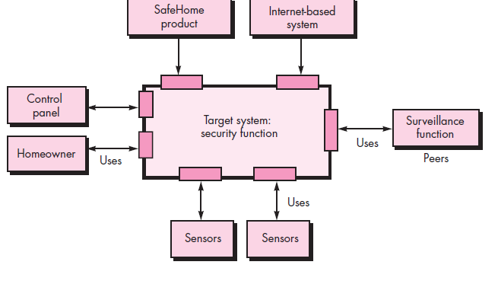
Architectural context diagram for the SafeHome security function

Slide 30
Defining Archetypes
Archetypes are the abstract building blocks of an architectural
design
For SafeHome home security function, you might define the following archetypes:
Node. Represents a cohesive collection of input and output elements of the home security function. For example a node might be comprised of (1) various sensors and (2) a variety of alarm (output) indicators.
Detector. An abstraction that encompasses all sensing equipment that feeds information into the target system.
Indicator. An abstraction that represents all mechanisms (e.g., alarm siren, flashing lights, bell) for indicating that an alarm condition is occurring.
Controller. An abstraction that depicts the mechanism that allows the arming or disarming of a node. If controllers reside on a network, they have the ability to communicate with one another.

Slide 31
Refining the Architecture into Components
Components of software architecture are derived from three sources
1) Application domain
2)infrastructure domain
3)The interface domain.

Slide 32
Assessing alternative architectural designs

Slide 33
Assessing alternative architectural designs
An Architecture Trade-Off Analysis Method
Architectural Complexity
Architectural Description Languages

Slide 34
An Architecture Trade-Off Analysis Method
The Software Engineering Institute (SEI) has developed an architecture trade-off analysis method (ATAM) [Kaz98] that establishes an iterative evaluation process for software architectures. The design analysis activities that follow are performed iteratively:
Collect scenarios.
Elicit requirements, constraints, and environment description
Describe the architectural styles/patterns that have been chosen to address the scenarios and requirements. The architectural style(s) should be described using one of the following architectural views:
Module view for analysis of work assignments with components and the degree to which information hiding has been achieved.
Process view for analysis of system performance.
Data flow view for analysis of the degree to which the architecture meets functional requirements.

Slide 35
An Architecture Trade-Off Analysis Method
4. Evaluate quality attributes by considering each attribute in isolation.
5. Identify the sensitivity of quality attributes to various architectural attributes for a specific architectural style.
6. Critique candidate architectures (developed in step 3) using the sensitivity analysis conducted in step 5.

Slide 36
Architectural Complexity
A useful technique for assessing the overall complexity of a proposed architecture is to consider dependencies between components within the architecture.
Three types of dependencies:
1)Sharing dependencies:
represent dependence relationships among consumers who use the same resource or producers who produce for the same consumers. For example, for two components u and v, if u and v refer to the same global data, then there exists a shared dependence relationship between u and v.
2)Flow dependencies:
represent dependence relationships between producers and consumers of resources. For example, for two components u and v, if u must complete before control flows into v prerequisite), or if u communicates with v by parameters, then there exists a flow dependence relationship between u and v.

Slide 37
Architectural Complexity
3)Constrained dependencies:
represent constraints on the relative flow of control among a set of activities. For example, for two components u and v, u and v cannot execute at the same time (mutual exclusion), then there exists a constrained dependence relationship between u and v.

Slide 38
Architectural Description Languages
Architectural description language (ADL) provides a semantics and syntax for describing a software architecture.

Slide 39
Mapping Dataflow into a Software Architecture

Slide 40
Mapping Dataflow into a Software Architecture

